Slide 1
Forward & Backward Propagation in Neural Networks

Slide 2
Agenda
Important Notations
Matrix Representation
Forward propagation
Random Weight Initialization
Gradient Descent in Neural Network
Backward Propagation in Neural Network
End-to-End process.
NN equations and Shapes.
Derivation of loss function w.r.t weights.

Slide 3

Notations
a₁^{[1]} = activation_function(
W₁₁^{[1]} *a₁^{[0]} +
W₁₂^{[1]} *a₂^{[0]} +
W₁₃^{[1]} *a₃^{[0]} +
B1)
A_{i}^{[0]}
A_{i}^{[1]}
A_{i}^{[2]}
A_{i}^{[3]}
a₁^{[1]}
a₁^{[2]}
a₁^{[0]}
a₂^{[1]}
a₂^{[2]}
a₂^{[0]}
a₁^{[4]}
a₃^{[2]}
a₂^{[1]} = activation_function(
W₂₁^{[1]} *a₁^{[0]} +
W₂₂^{[1]} *a₂^{[0]} +
W₂₃^{[1]} *a₃^{[0]} +
B2)
a₃^{[1]}
Input Data
a₃^{[0]}
a₄^{[1]}
a₄^{[2]}
W_{ij}^{[1]}
W_{ij}^{[2]}
W_{ij}^{[3]}
Input Layer
Hidden Layer
Output Layer
Notes:
Last session was about what is nueral network , today we will investigate how neural network work.
We pass the data to the input layer then do a weighted sum by multiplying the weights with the neurons, then pass it thru the activation function . This defines the neurons for the next layer.
Every neuron is represented as a1[0] , where the superscript in bracket represent the layer, input layer is 0 and first hidden layer as 1 the first layer and so on. So we can represent the neuron with A.
Every interaction between the neuron is assigned Weight, which means position of the weight between W11 is the weight between a1[1] and a1[0], W12 is the weight between a1[1] and a2[0], and so on.
Now the value of a1[1] can be calculated by these weights with the neurons in the input layer and then doing the sum and then passing it thru the activation function.
So to make the computation easy we will look at the matrix representation of the weights and the activations .

Slide 4
Matrix Representation
A1 = f(W1 * A0 + B1)
A2 = f(W2 * A1 + B2)
W₁₁ W₁₂ W₁₃
W₂₁ W₂₂ W₂₃
W₃₁ W₃₂ W₃₃
W₄₁ W₄₂ W₄₃
a₁^{[0]}
a₂^{[0]}
a₃^{[0]}
*
W =
n_x x 1
n_h x n_x
W₁₁^{[1]} *a₁^{[0]} + W₁₂^{[1]} *a₂^{[0]} + W₁₃^{[1]} *a₃^{[0]}
W₂₁^{[1]} *a₁^{[0]} + W₂₂^{[1]} *a₂^{[0]} + W₂₃^{[1]} *a₃^{[0]}
W₃₁^{[1]} *a₁^{[0]} + W₃₂^{[1]} *a₂^{[0]} + W₃₃^{[1]} *a₃^{[0]}
W₄₁^{[1]} *a₁^{[0]} + W₄₂^{[1]} *a₂^{[0]} + W₄₃^{[1]} *a₃^{[0]}
a₁^{[1]}
a₂^{[1]}
a₃^{[1]}
a₄^{[1]}
= f
=
+ B1
=
n_h x 1
n_h x 1
n_x x 1
Notes:
1) For example, matrix of all the weights W will be given as … where n_h is the number of neurons in the hidden layer, while n_x is the number of neurons in the input layer given as …(2)
3) When we multiply the W and the input matrix, we get the resultant matrix , which can be used to add the Bias (4) and applying the activation function f (5). To get the activation of the next hidden layer.

Slide 5
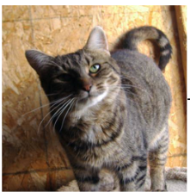
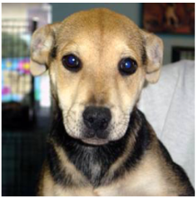
Notes:
Important point to note here is activation function is dependent on the input passed, so for different input different neurons are activated and these activated affect the neuron in the next layer and generate the output.
So we obtain the final output by propagating the information from the input layer to the final output layer, as we are moving in the forward direction this step is called FORWARD propagation.

Slide 6

Forward Propagation
Z1 = W1 * A0 + B1
A1 = f ( Z1 )
Z2 = W2 * A1 + B2
A2 = f ( Z2 )
Z3 = W3 * A2 + B3
A3 = f ( Z3 ) = Output Prediction
Weight Initialization ??
W₁₁ W₁₂ W₁₃
W₂₁ W₂₂ W₂₃
W₃₁ W₃₂ W₃₃
W₄₁ W₄₂ W₄₃
MANUAL
W =
Notes:
So forward propagation equation are given as:
To ease we divide the equation into two steps, where we compute Z1 and then pass it thru activation function to obtain A1,
A0 is our input layer, which is used to calculate A1, A1 is further passed to compute Z2 and the passed through the activation function to compute A2. and so on to get the output prediction.
What values should the weights be initialized with, so that it can generate proper output Predictions . Manual assignment is not feasible due to large number of layers and nuerons.

Slide 7
Weight Initialization
Random Weights
After Training
Trained Weights
Cost Function
= Error Representation
Cost Function -> A3 -> Weights
Network Performance
Cost Function
Notes:
So we can assign random weights, then train the model and after training the value of these weights will be changed in such a way that the network produces correct output.
To do this we need to understand Cost function, which is nothing but error representation.
Cost function computes the error of predictions compared to the actual label, it depends on our output A2 and hence the weights.
So we need to tweak the weights such that the cost can be minimized and hence the improve the accuracy of the network.

Slide 8
Slope of the graph
Cost
W = W – α * dCost/dW
Learning Rate
-ve
Slope
Gradient Descent
+ve
Slope
Weights
Notes:
Plotting the cost function and one of the weight parameter, the graph would look something like this.
The local minima will lie somewhere here. Assuming the cost function value lies here, so we need to reach from there to the local minima. To do so we will iterate through these steps until we reach the local minima.
Initially starting from the left side of the graph, the slope is going to be –ve and so we will be adding a small value to weight, there by reducing the cost moving closer to the minima. This continues until we overshoot on the other side of the graph.
On the right side the slope will be +ve and reduce W, thus moving towards the local minima. This entire process is called Gradient Descent.
Remember this is wrt to just one of the weights, but we will have to repeat this for all the weights. And the gradient descent equation will look like this.

Slide 9
Gradient Descent
Repeat {
W3 = W3 – α * dCost/DW3
B3 = B3 – α * dCost/DB3
W2 = W2 – α * dCost/DW2
B2 = B2 – α * dCost/DB2
W1 = W1 – α * dCost/DW1
B1 = B1 – α * dCost/DB1
}
W2
W1
a₁^{[1]}
a₁^{[2]}
W3
a₁^{[0]}
a₂^{[1]}
a₂^{[2]}
a₂^{[0]}
a₁^{[4]}
Cost
a₃^{[1]}
a₃^{[2]}
a₃^{[0]}
a₄^{[1]}
a₄^{[2]}
Back-Propagation
Notes:
To find the dcost/dW, we need to use cost which depends on A3, which further depends on W3 and A2 …
As we need to move backward from the output to the input layer, this process is called Backward propagation. With this we will be able to update all our weights and biases thus training the model.

Slide 10
How a NN is trained : E2E
Step1 : Initialize the weights Randomly
Step2 : Forward Propagation
Z1 = W1 * A0 + B1
A1 = f ( Z1 )
Z2 = W1 * A1 + B1
A2 = f ( Z2 )
Z3 = W1 * A2 + B1
A3 = f ( Z3 )
Step3 : Find value of Cost Function
Step4 : Backward Propagation
W3 = W3 – α * dCost/DW3
B3 = B3 – α * dCost/DB3
W2 = W2 – α * dCost/DW2
B2 = B2 – α * dCost/DB2
W1 = W1 – α * dCost/DW1
B1 = B1 – α * dCost/DB1
W3 – α Step5 : Repeat steps 2- 4 until we local minima is reached.

Slide 11
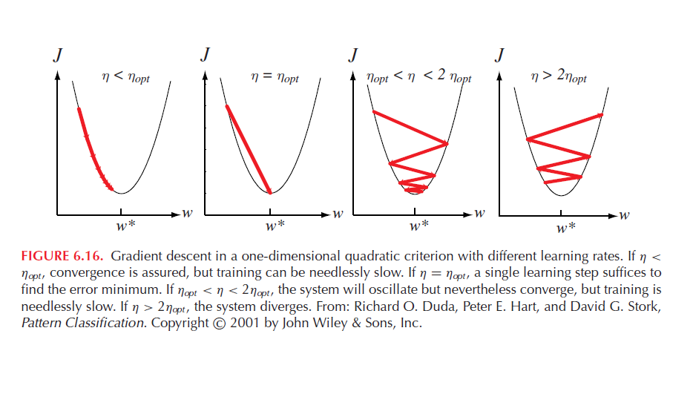
Learning Rate ( α )
From: Pattern Classification Duda & Hart
Notes:
Different learning rates affect the performance of a neural network significantly.
Convergence is assured, but training is very slow
Single learning step suffices to find the minimum error.
The system will oscillate but will converge with very slow training
The system diverges.

Slide 12
Back-Propagation Derivation
Backward Propagation
W3 = W3 – α * dCost/DW3
B3 = B3 – α * dCost/DB3
W2 = W2 – α * dCost/DW2
B2 = B2 – α * dCost/DB2
W1 = W1 – α * dCost/DW1
B1 = B1 – α * dCost/DB1
A1
A2
A0
A3
Input
W2
W3
Output
W1
Notes:
Now we will look how to derive these dCost/dW and dCost/dB

Slide 13
NN Equation and Shapes : Matrix Representation
Shape of W1 = (n₁, n₀)
Shape of W2 = (n₂, n₁)
Shape of W3 = (n₃, n₂)
Shape of B1 = (n₁, 1)
Shape of B2 = (n₂, 1)
Shape of B3 = (n₃, 1)
W₁₁ W₁₂ W₁₃
W₂₁ W₂₂ W₂₃
W₃₁ W₃₂ W₃₃
W₄₁ W₄₂ W₄₃
a₁^{[0]}
a₂^{[0]}
a₃^{[0]}
*
W =
n_x x 1
n_h x n_x
W₁₁^{[1]} *a₁^{[0]} + W₁₂^{[1]} *a₂^{[0]} + W₁₃^{[1]} *a₃^{[0]}
W₂₁^{[1]} *a₁^{[0]} + W₂₂^{[1]} *a₂^{[0]} + W₂₃^{[1]} *a₃^{[0]}
W₃₁^{[1]} *a₁^{[0]} + W₃₂^{[1]} *a₂^{[0]} + W₃₃^{[1]} *a₃^{[0]}
W₄₁^{[1]} *a₁^{[0]} + W₄₂^{[1]} *a₂^{[0]} + W₄₃^{[1]} *a₃^{[0]}
a₁^{[1]}
a₂^{[1]}
a₃^{[1]}
a₄^{[1]}
= f
=
+ B1
=
n_h x 1
n_h x 1
n_x x 1

Slide 14
NN Equation and Shapes
If m is the total number of observations/samples in the dataset.
Shape of input = (n₀, m) , where n₀ is the features.
Shape of A₁ = (n₁, m)
Shape of A₂ = (n₂, m)
Shape of A₃ = (n₃, m) = Y (output prediction)
Activation Function : A₁ = f(Z₁), A₂ = f(Z₂) [Relu/tanh]
Output layer : A₃ = Sigmoid(Z₃) Sigmoid / Softmax
Z_{k} = W_{k} * A_{k-1} + B_{k}

Slide 15
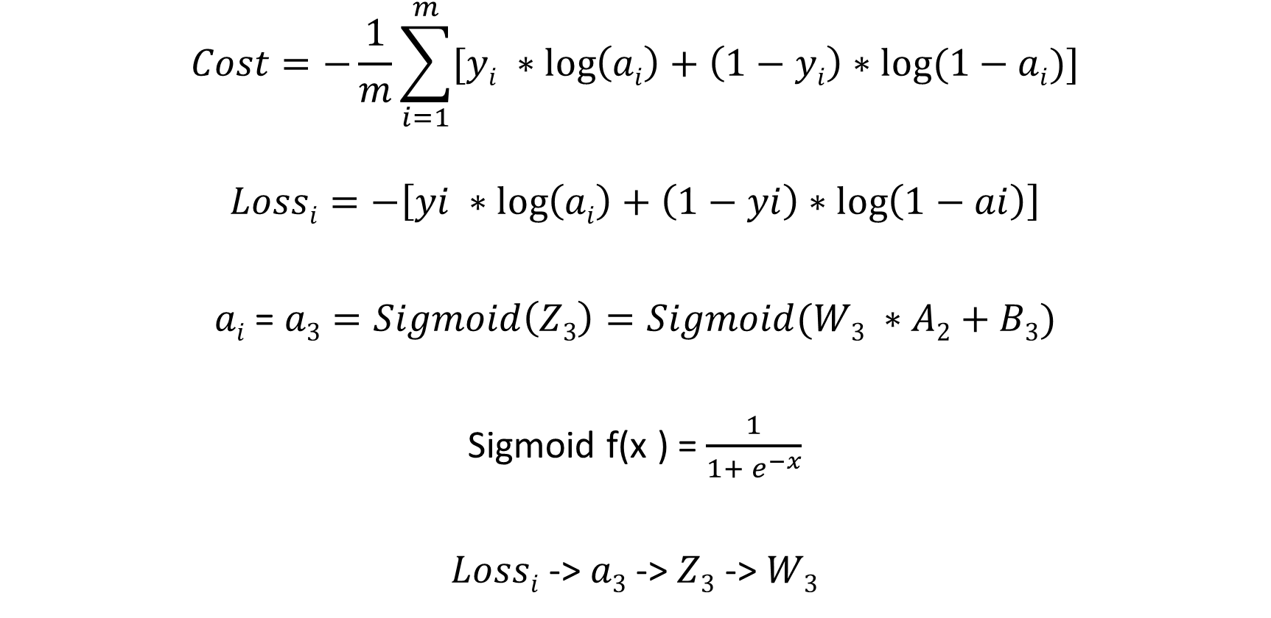
Logistic Regression Cost Function
$$Cost=−\frac{1}{m}\sum_{i=1}^{m}{[yi ∗\log\left(ai\right)+\left(1−yi\right)∗log⁡(1−ai)]}$$
$$Lossi=−\left[yi ∗\log\left(ai\right)+\left(1−yi\right)∗\log\left(1−ai\right)\right]$$
$ai$ = $a3=Sigmoid\left(Z3\right)=Sigmoid(W3 ∗A2+B3)$
Sigmoid f(x ) = $\frac{1}{1+ e^{−x}}$
$Lossi$ -> $a3$ -> $Z3$ -> $W3$
Loss or the error for one observation is given by
Notes:
Loss or the error for one observation is given by

Slide 16



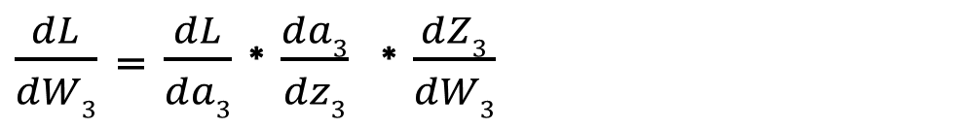
$$Lossi=−\left[yi ∗\log\left(ai\right)+\left(1−yi\right)∗\log\left(1−ai\right)\right]$$
Chain Rule:
$\frac{dL}{da3}$ = $\frac{−y}{a3}$ - $\frac{(1−y)}{(1−a3)}$ $\left(−1\right)$ = $\frac{−y+ya3+a3 −ya3}{a3(1−a3)}$ = $\frac{(a3−y)}{a3 ∗(1−a3)}$
$\frac{da3}{dZ3}$ = $\frac{d{(1+{ e}^{−z3})}^{−1}}{dZ3}$ = $\left(−1\right) {(1+{ e}^{−z3})}^{−2}$ ${−e}^{−z3}$ = $\frac{e^{−z3}}{{(1+{ e}^{−z3})}^{2}}$ = ${a3}^{2}$ ${∗e}^{−z3}$
${=a3}^{2} ∗\frac{(1−a3)}{a3}$ $=a3 (1−a3)$
$\frac{dZ3}{dW3}$ $=a2$
$\frac{dL}{dW3}$ = $\frac{(a3−y)}{a3 ∗(1−a3)} ∗$ $a3 (1−a3)$ $∗$ $a2$ $=a2 (a3−y)$
$\frac{dL}{dW3}$ = $\frac{dL}{da3}$ * $\frac{da3}{dz3}$ * $\frac{dZ3}{dW3}$
$$a3=Sigmoid\left(Z3\right)$$
Sigmoid f(x ) = $\frac{1}{1+ e^{−x}}$
$$Z3=W3 ∗A2+B3$$
This Loss computation is just for one observation

Slide 17
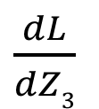
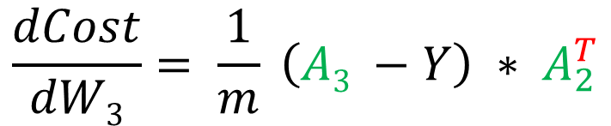

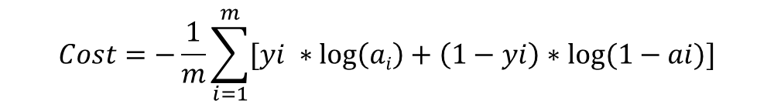


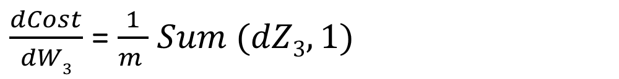
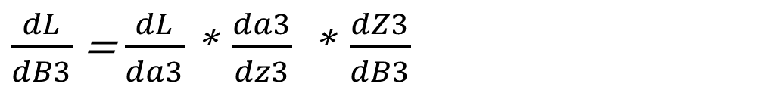
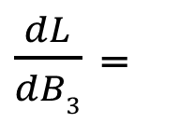
$$Cost=−\frac{1}{m}\sum_{i=1}^{m}{[yi ∗\log\left(ai\right)+\left(1−yi\right)∗log⁡(1−ai)]}$$
$$\frac{dCost}{dW3}= \frac{1}{m} \left(A3 −Y\right) ∗ A_{2}^{T}$$
$$Z3=W3 ∗A2+B3$$
(n₃, m)
(n₂, m)
(n₃, n₂)
$\frac{dL}{dB3}$ = $\frac{dL}{da3}$ * $\frac{da3}{dz3}$ * $\frac{dZ3}{dB3}$
$$(a3−y)$$
$$∗1$$
$\frac{dL}{dB3}$ =
$\frac{dL}{dZ3}$
dZ₃
(n₃, m)
(n₃, 1)
$\frac{dCost}{dW3}$ = $\frac{1}{m }$ $Sum (dZ3, 1)$
Column wise summation

Slide 18
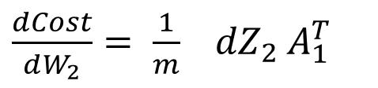
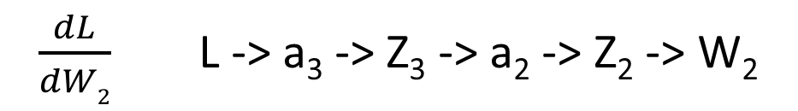

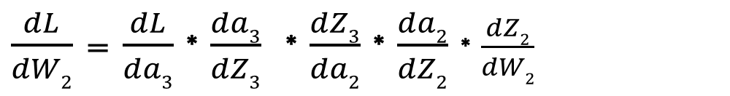


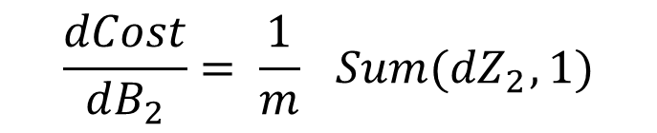
$\frac{dL}{dW2}$ L -> a₃ -> Z₃ -> a₂ -> Z₂ -> W₂
$\frac{dL}{dW2}$ = $\frac{dL}{da3}$ * $\frac{da3}{dZ3}$ * $\frac{dZ3}{da2}$ * $\frac{da2}{dZ2}$ * $\frac{dZ2}{dW2}$
$$Z3=W3 ∗A2+B3$$
A₂ = f(Z₂)
dZ₃
W₃
$f_{2}^{′}$(Z₂)
a₁
$${dZ}_{2}$$
$\frac{dCost}{dW_{2}}= \frac{1}{m}{ dZ}_{3} W_{3}^{T}{ f}_{2}^{′}Z_{2 }{ A}_{1}$
(n₃, m)
(n₃, n₂)
(n₂, m)
(n₁, m)
(n₂, n₁)
(n₂, m)
*
(n₂, m)
(n₁, m)^{T}
Elementwise multiplication
$\frac{dCost}{dW_{2}}= \frac{1}{m}{ dZ}_{2}$ $A_{1}^{T}$
$$\frac{dCost}{dB_{2}}= \frac{1}{m}{ Sum(dZ}_{2}, 1)$$

Slide 19
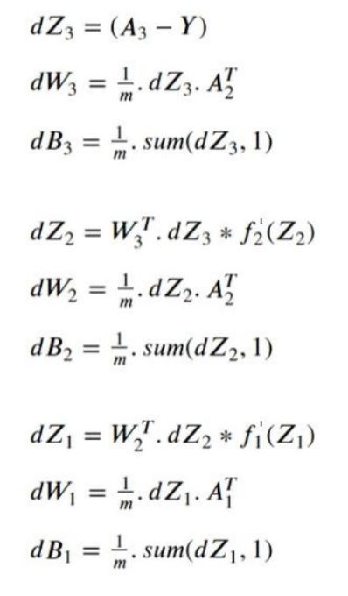
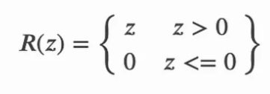
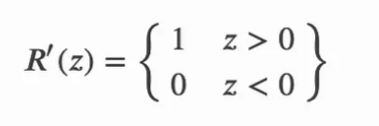
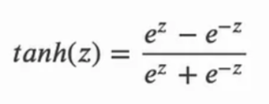

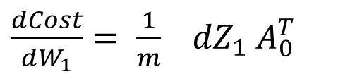

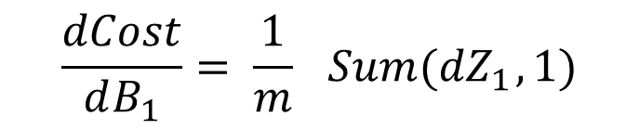
$\frac{dCost}{dW_{1}}= \frac{1}{m}{ dZ}_{1}$ $A_{0}^{T}$
Back-Propagation Steps : Summarized
$A_{0}^{T}$ = X (Input)
$$\frac{dCost}{dB_{1}}= \frac{1}{m}{ Sum(dZ}_{1}, 1)$$
For Practise:
Derive the dCost/dW₁
Derivative of activation function can be Relu or Tanh

Slide 20
Thanks

